Slide 1

Objects and Subsystems
Formal Programming Standard

Slide 2
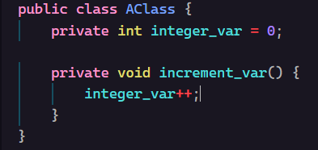
What is a Class?
A class is a blueprint. It tells the code how to store data and what to do with it. Imagine a class as a blueprint for a house. The class tells the builders what to put in the house, what amenities, furniture, and structure the house needs to be.
In programming, a class is a block of code dedicated to doing just that. A class defines the information an object needs to store, as well as certain functions that can do things with the data. A class does this with two basic features: variables and methods.

Slide 3
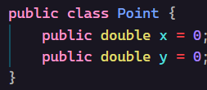

Class Variables
Classes use variables to define the data they store. For example, a Point class would hold the data of a point: $\left(p_{x},p_{y}\right)$. In programming, this translates to two variables of type double. These variables store the x and y coordinates of the point.

Slide 4
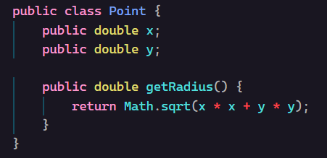

Class Methods
Classes can store data with variables, but they can also have special functions with the data. For example, going back to the Point class, which stores $(p_{x},p_{y})$, we can define a method in the class to get the distance from the origin to the point (formula: $\sqrt{{p_{x}}^{2}+{p_{y}}^{2}}$).

Slide 5
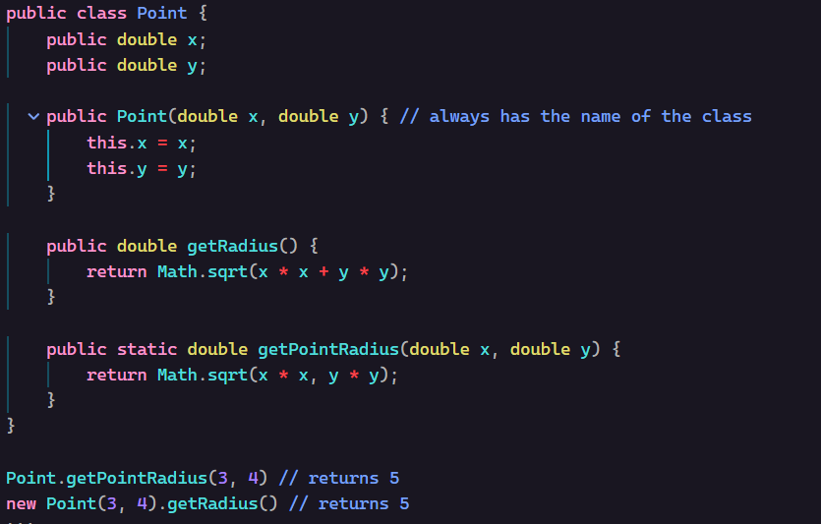
Constructors
A constructor is the function that controls what happens when an object is built from a class. It can do things like set default variable values, change static variables, and set variables to parameter values. When a constructor parameter (or any non-static parameter) is the same name as a class variable (hereafter referred to as a member variable), then you can use this.variable_name to reference the member variable instead of the parameter.

Slide 6
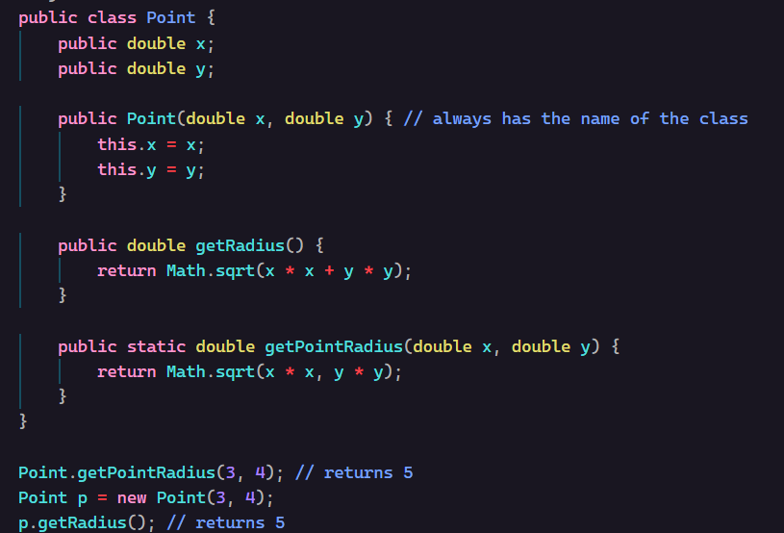
Creating an Object
Creating an object is relatively simple in Java. You first declare a variable with the class as your type name. Then, you initialize it to a new object by writing “new ClassName();”. You can pass in constructor parameters to the parenthesis after the ClassName.

Slide 7
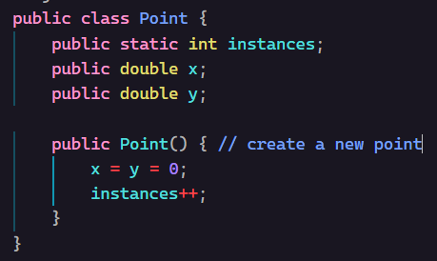
Class Variables (cont.)
Additionally, classes can store static variables. These variables are owned by the class instead of the object, which means that instead of each object of a class having its own version of the variable, there’s only one version, the class’s version. A common example of a static variable is a variable that tracks how many instances of an object have been created. A static variable is required because the variable is being used to represent a quantity unrelated to each individual object.

Slide 8
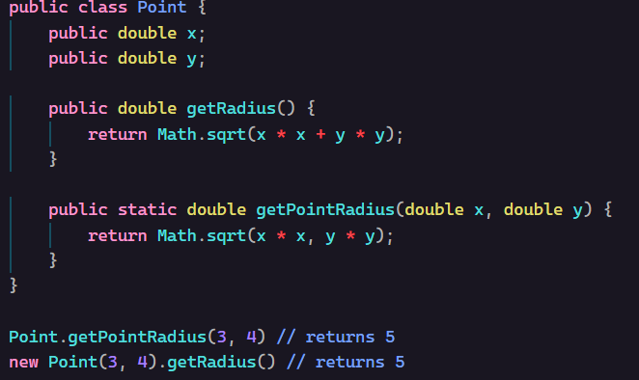
Class Methods (cont.)
A function in a class (a method) is used to manipulate the data in the class, as seen in the last slide. However, if there is a function related to the class but not dependent on a specific object’s data, it can be made a static method.
A static method is called from the class itself, and not from an object

Slide 9
What is a Subsystem?
A subsystem is a type of class in WPILib integrated into WPI’s command-based structure. A subsystem is a class which represents a physical mechanism on the robot, everything from a shooter to an arm to a drivetrain. The reason we use WPILib’s subsystems is that it works with the command scheduler to make sure that every subsystem is only running one command, which keeps the subsystem from trying to do two things at once. To make a class a subsystem, you simply need to put “extends SubsystemBase” after the class name.

Slide 10
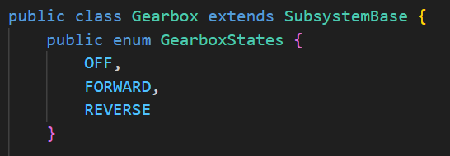
State Machines
A state machine in the context of Beak Squad programming refers to an enum (enumeration) specifying specific states that the mechanism can be in. An enum is simply a list of named constants that are internally mapped to numbers and are the best way to represent states. For example, in our gearbox subsystem, the states could be OFF, FORWARD, and REVERSE.

Slide 11
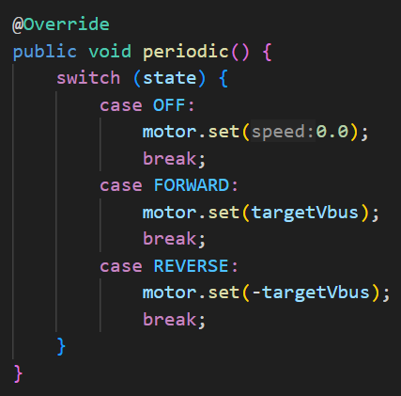
Reading State Machines
To make the motor do what the state tells it, we must head over to every subsystem’s built-in periodic method (don’t forget the @Override). Going back to the infeed example, we can use a special keyword called switch to set the motor to a speed dependent on the mechanism state.

Slide 12
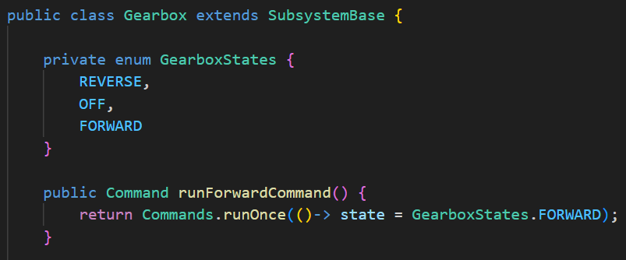
Switching States
To switch subsystem states, we use a command to manipulate the internal state variable.

Slide 13

State Targets
In addition to a state controlling the function of a subsystem, associated target variables can also be used to affect subsystem behavior. For example, if we want to change the target speed of our gearbox, it can be manipulated using a method to set this as well.

Slide 14
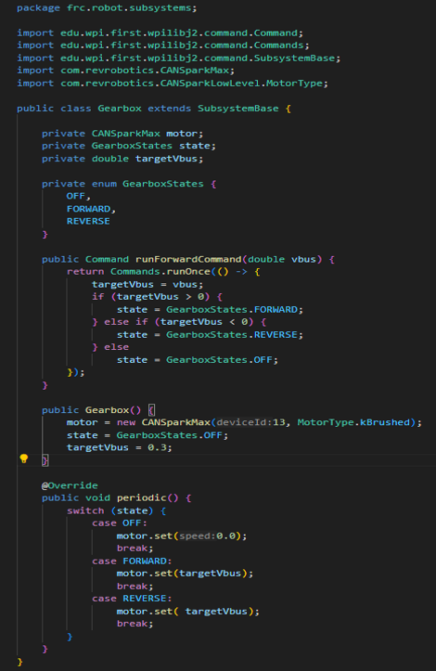
Putting it all together: creating a subsystem

Slide 15

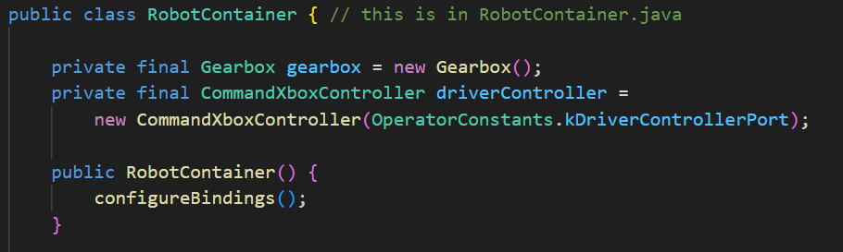

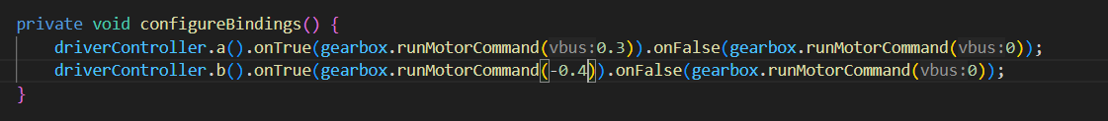
Putting it all together: using the subsystem
In RobotContainer, we can bind our new state-based functions to buttons…
Notes:
Exercise: Have folks turn their Gearbox code into a subsystem following this paradigm.

